Slide 1
Novel Computational Approaches to Investigate Microbial Diversity
Qingpeng Zhang
Department of Computer Science and Engineering
Michigan State University
Advisor: Dr. Titus Brown
Notes:
Thanks a lot for Titus’s introduction. Good afternoon. Firstly thanks for coming to my talk. I have been wokring on several differnet projects during my phd study. But today my talk will be fosucd on one project,or one story about my effort to answer one very question. How to investiaget microbial diversity, effectively and efficiently. If you have any question, please stop me and ask.

Slide 2
Outline
Background and motivation
An efficient k-mer counting approach
Novel method to investigate microbial diversity
Concept of IGS (informative genomic segment)
Testing IGS method on simulated data sets
Testing IGS method on real metagenome data
Summary
Background and motivation
Notes:
Ok let’s talk about motivation. Why we want to do this. Try so hard to investiage microbial diversity.

Slide 3
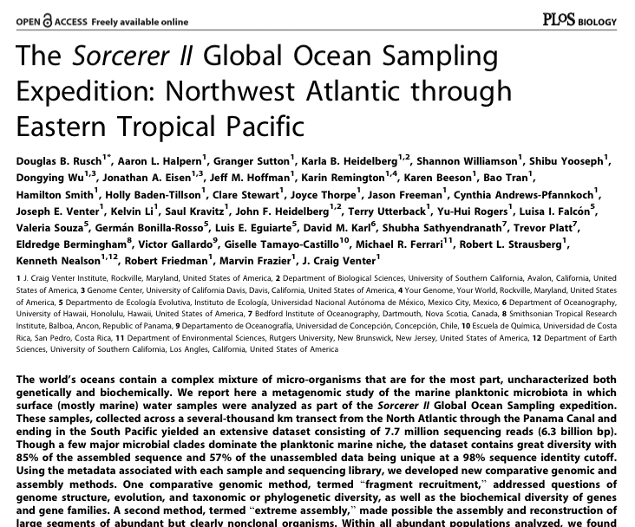
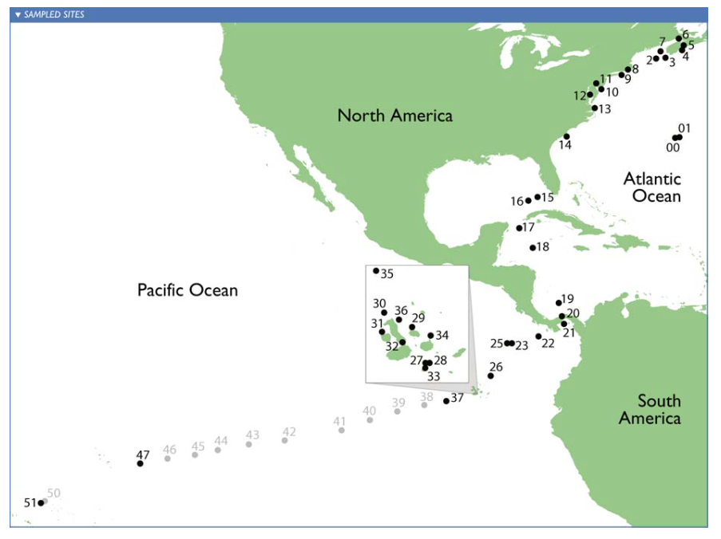

Microbial diversity: Sorcerer II Global Ocean Sampling Expedition
How many different species in a sea water sample? What is their abundance distribution? (alpha-diversity) [Hint: ~10,000 different types of microorganisms]
Are samples from tropical area and temperate area different?(beta-diversity) [Hint: Yes, but how different?]
Notes:
Species diversity is an important measurement of ecological
communities. Scientists believe that there is a strong relationship between species diversity and ecosystem processes. It is not surprisne that environment has influence to the composition of species in a sample. For example, in 2007, scientist sailed a ship called sorecere ii from norht atlanta to caribbean to south pacific and collected the marine samples in different locations. by the way I am so jealously of their samping journey, it is so cool. All the efforts of sampling want to answer questions like this: firstly.. This is alpha diversity. About the richness of species, or evenness of distribution.
The other question to ansser is are the sampels different? If thery are collected from different locations. Such comparison between samples is beta diversity.
So alpha and beta diversity are the two most important aspects of diveriisyt analysis, which will be the target of my project is to find a way to maeasure lpha and beta diversity efficiently and effectively.

Slide 4
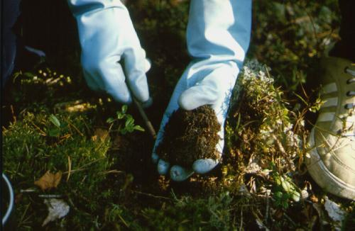
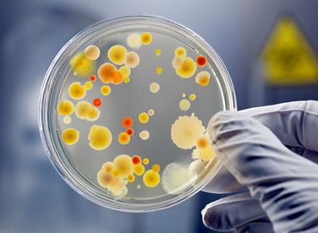
Metagenomics and
“big data”
Most of the microorganisms can not be cultured and isolated and sequenced in way.
”...functional analysis of the collective genomes of soil microflora, which we term the metagenome of the soil.”
- J. Handelsman et al., 1998
In a gram of soil, there are approximately a billion microbial cells, containing an estimated 4 petabase pairs of DNA (Jack A. Gilbert,2013)
+
Improvement of next generation sequencing = data deluge
+
Decreasing cost of sequencing
Notes:
So to do measure diversity it looks like straightforwad, just like we count the types of birds in a forest, lets just go to the forest and find them and count them. Unfortunately for microbial smaple,s it’s not that easy. Most of the micr. Andnot be cultured and isolated. Sequenced in traditionaly way , what we can do is to do the sequencing directly without separating the organisms in the sample. This approach is just metagenomics, which was coined 17 years ago by dr. handelsman. As he said ,metagenomis is the functioanl analysis of the collenctive ….
The first problem we have is hat for metagenomics research, because of the high diversity of environmental samples, for examples, mentioned , 10 milion, for soil, it is more crasy, a billion, cells in a gram , 4 peta base pairs of dna. Also now we have more powerful nextgeneratio sequencing technolgy, the cost of sequencing is dropping. Like you can sequence your own genome with 1 000 dollors. Finally we are facing the data deluge

Slide 5

Metagenomics and
“big data”
”...functional analysis of the collective genomes of soil microflora, which we term the metagenome of the soil.”
- J. Handelsman et al., 1998
most of the microorganisms can not be cultured and isolated and sequenced in traditional way.
In a gram of soil, there are approximately a billion microbial cells, containing an estimated 4 petabase pairs of DNA (Jack A. Gilbert,2013)
+
Improvement of next generation sequencing = data deluge
+
Decreasing cost of sequencing
Notes:
. It will not only flood your laptop,

Slide 6
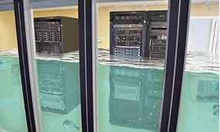
Metagenomics and
“big data”
”...functional analysis of the collective genomes of soil microflora, which we term the metagenome of the soil.”
- J. Handelsman et al., 1998
most of the microorganisms can not be cultured and isolated and sequenced in traditional way.
In a gram of soil, there are approximately a billion microbial cells, containing an estimated 4 petabase pairs of DNA (Jack A. Gilbert,2013)
+
Improvement of next generation sequencing = data deluge
+
Decreasing cost of sequencing
http://www.e-janco.com/
Notes:
But also super computer.

Slide 7
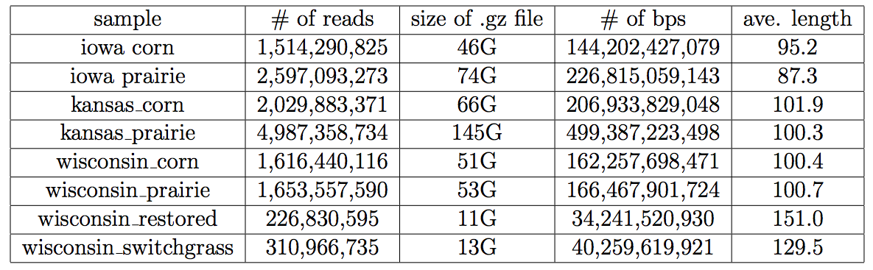
Metagenomics and
“big data”
Bacterial genome size: 139,000 bps to 13,000,000 bps
Human genome size: 3,000,000,000 bps
Tools friendly to big data are required.
Notes:
, this is a example of a soil metagenomic data sets.
The total size of compressed fasta file of htes 8 samples, is 500 gb, any kind of manupulaiton to this data, it’s easy to eat double of that size of space.
We cans ee for a moderate size sample, 1 billion, reads, 144 billion bps.
For comparison, bacterial genome, is tjust 1 million bp, and human genome 3 bilion bps.
many tools methods developed for single genome or smaller data sets, may not be useful , or efficient enough to deal with the big metagenome data.
Novel methods , scalable approahces are highly required. To fit the big data. And when we devlop emethod of rmetangoemic research, we shold alsways keep the huge size of data in mind.

Slide 8
Sorcerer II Global Ocean Sampling Expedition
How many different species in a sea water sample? What is their abundance distribution? (alpha-diversity) [Hint: ~10,000 different types of microorganisms, 10 million viruses, one million bacteria in a drop.]
Are samples from tropical area and temperate area different?(beta-diversity) [Hint: Yes, but how different?]
Notes:
Having talked about the technical obticle, now let’s go back to the questions to answer. Measure and compare the diversity of the samples colleteted from different locations. Actually here I want to draw an analogy between this abstract concept of microbial diversity stuff and slmething we are more familiar with.

Slide 9
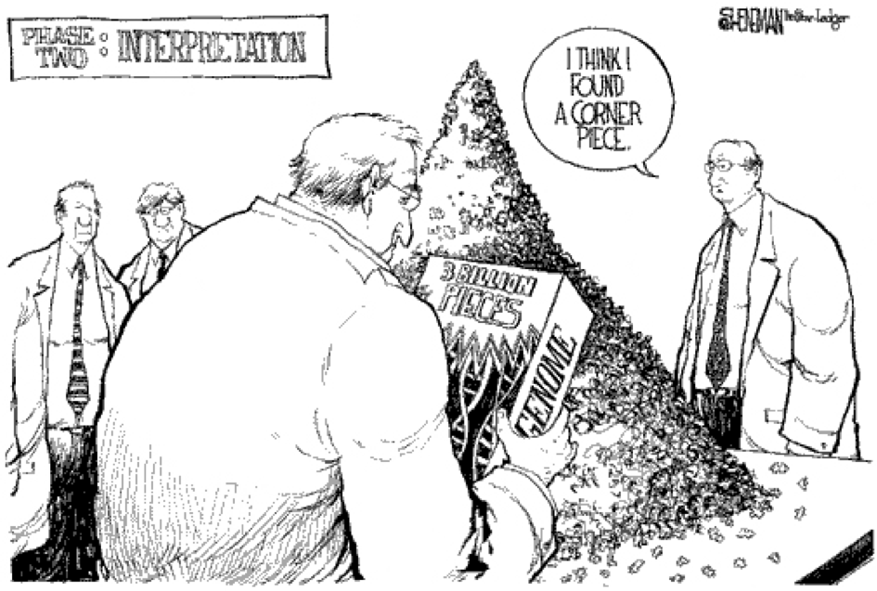
Genome and Book
Notes:
It is a popular analogy to draw between genome and book. The reads are like shreded pages, but may not like the real world, we can still read partial sentence on that.

Slide 10

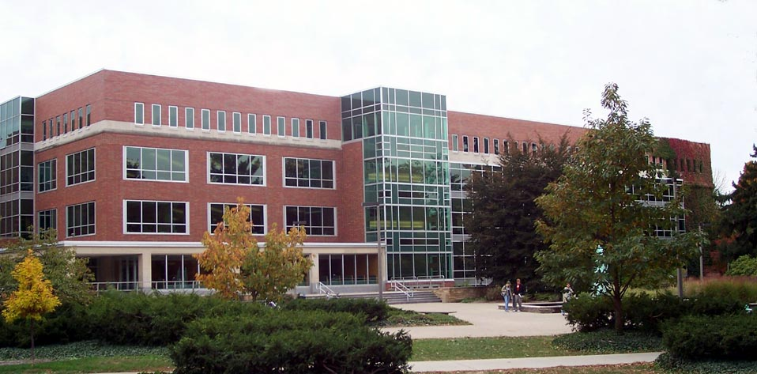

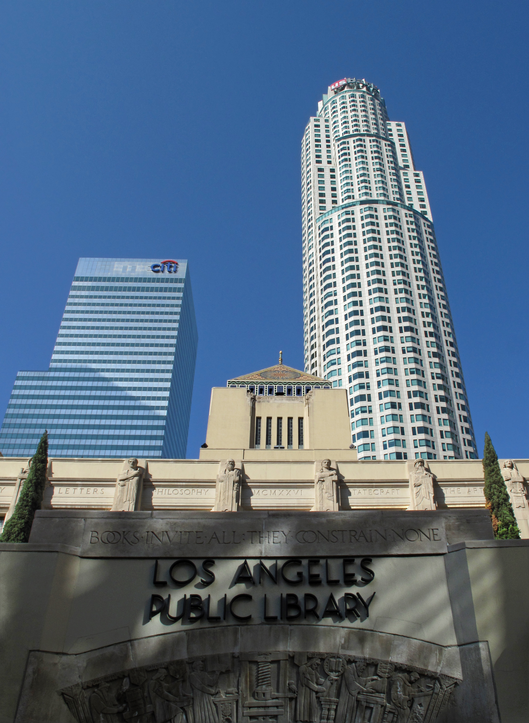
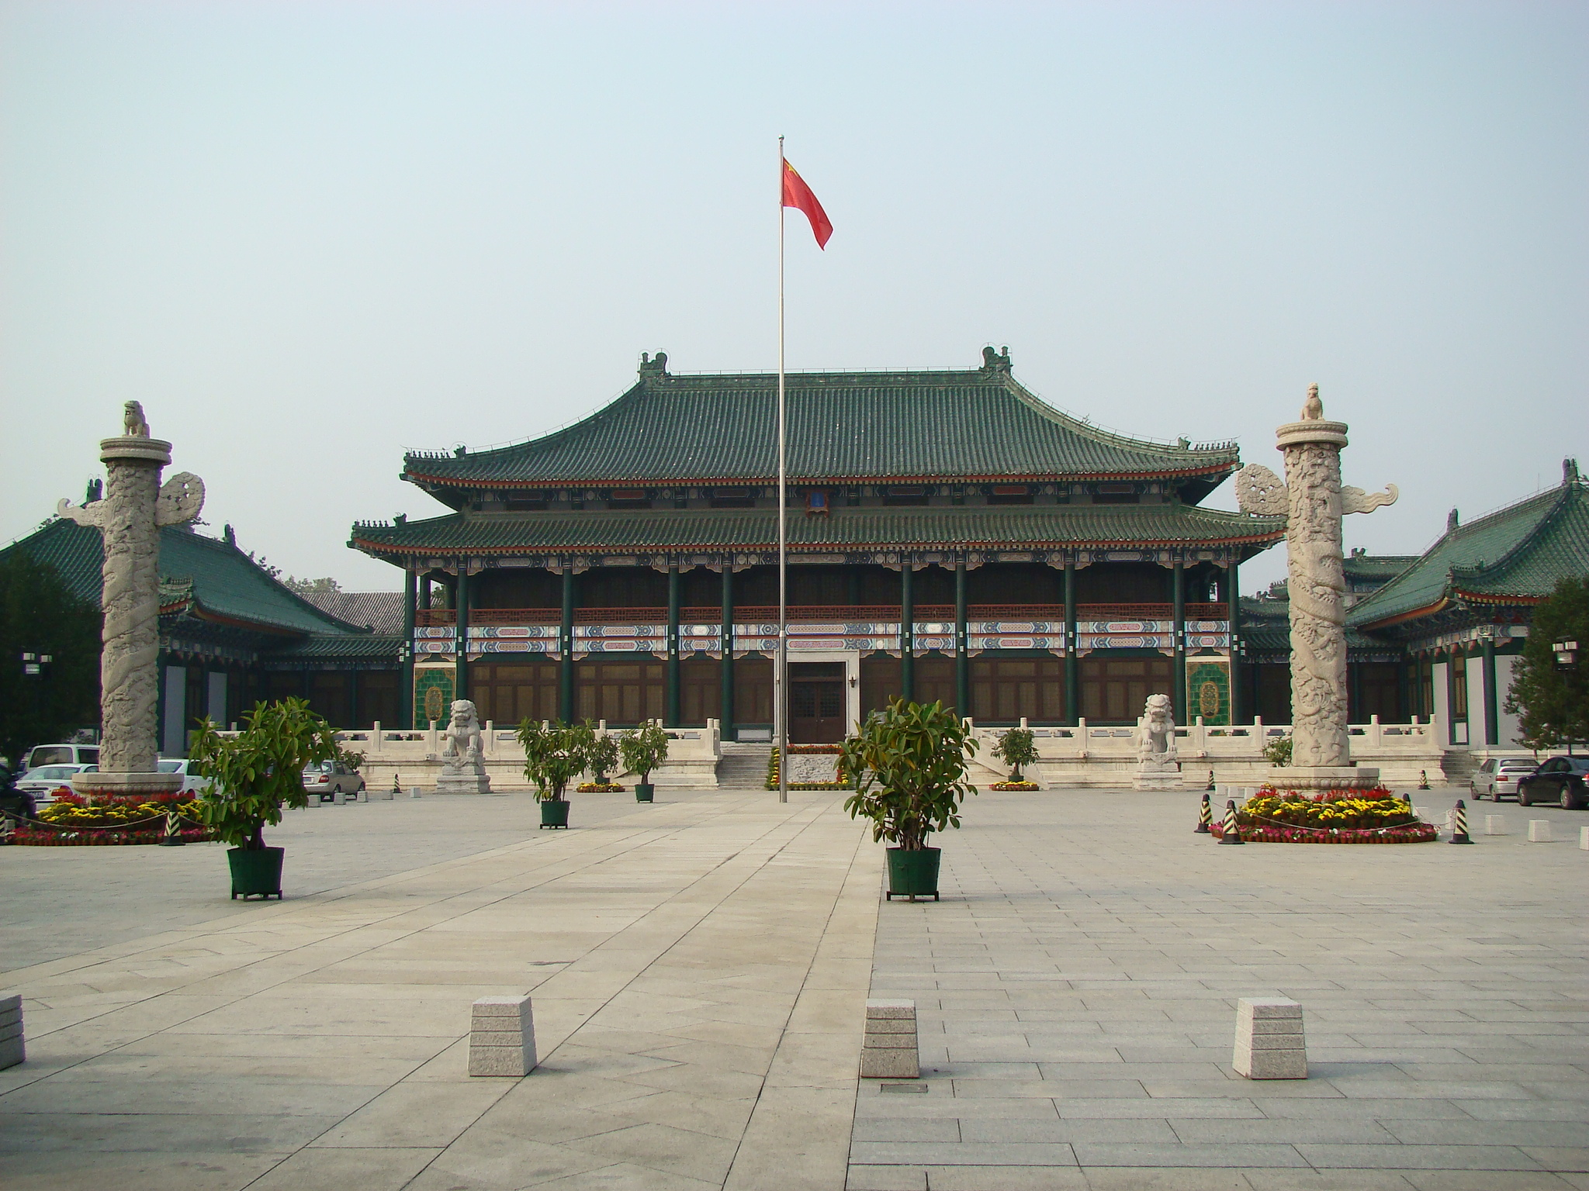
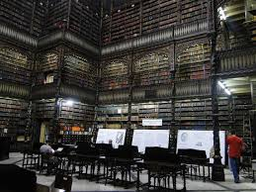


Sample and Library
Notes:
If a genome can be seen as a book. Then the samples with many species can be seen as library. Just like we have samples from different locations. We have library in different locationas around the world.
Analogy to library – books – shredded sentences

Slide 11
Which library has more titles?
Notes:
Now we ask diversity question to the libraries. Which library has more titles? Ok we can check each book. But for metagenomic data set, we can not count bacterials directly, we only have reads, from many species altogether.

Slide 12
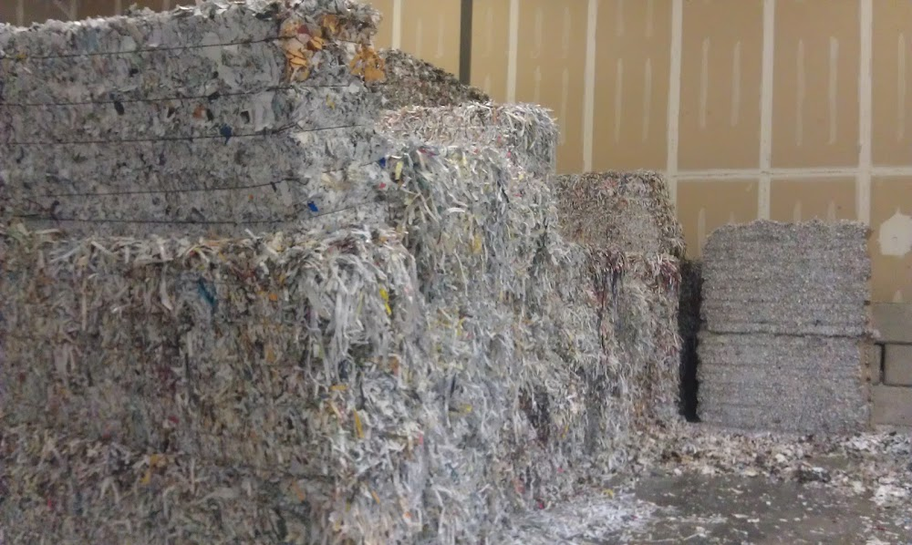
Which library has more titles?
With only shredded pieces of pages with (partial) sentences on it to read.
Notes:
We only have shredded pieces of pages of the books in the libraries. With the stackes of sheredded pages, can we answer the question ?

Slide 13
How similar are the libraries by their collection?
With only shredded pieces of pages with (partial) sentences on it to read.
Notes:
Similarity, beta diversity, how similar are the … by their collection? this looks challenging. Methods have been developed to answer such questions in metagenomics. Let’s have a ccheck

Slide 14
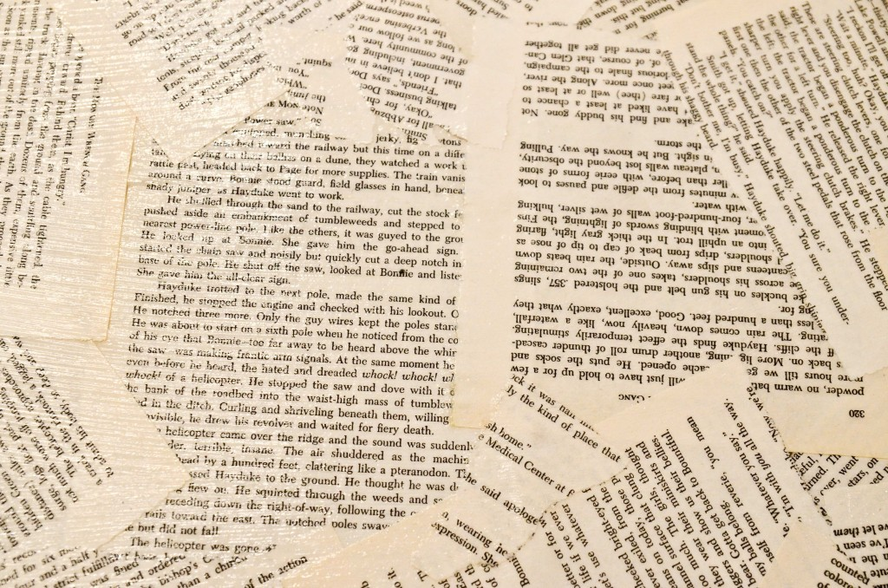

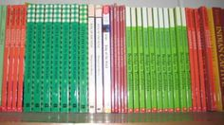
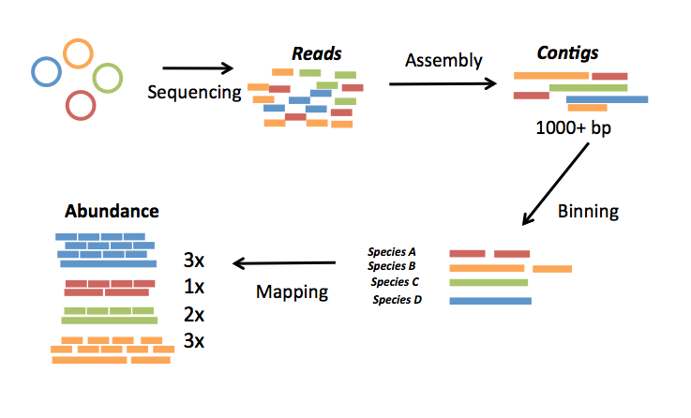
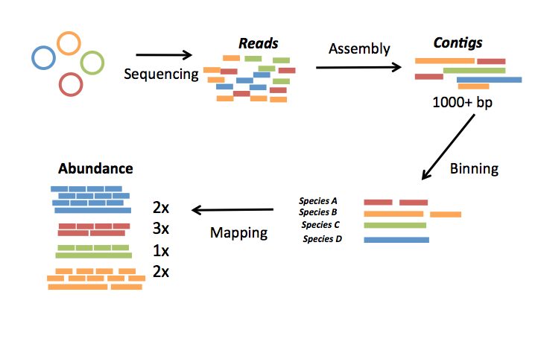
A typical pipeline of metagenome diversity analysis
Sample1
Reads
Assembly
Contigs
Sequencing
1000+ bp
100-150 bp
Abundance
Species
Binning
3x
1x
1x
2x
Species A
Species B
Mapping
Species C
Species D
 | Sample1 | Sample2 | Sample3 | Sample4 | Sample5
Species A | 3 | 3 | 4 | 4 | 0
Species B | 1 | 3 | 0 | 2 | 2
Species C | 1 | 2 | 2 | 2 | 3
Species D | 2 | 1 | 2 | 1 | 1
Sample5
Sample4
Sample3
Sample2
Loosely based on slide by Mads Albertsen
Notes:
So this is a typical pipeline of …..
Firstly we have discussed this, we do the sequencing to all the species algethter without isolating. Just like we got the stack of shreded pages. Then the reads will be assembly into contigs. It is like solve a puzzle, and recover the pages out of the shreaed pages. But we don’t know which books they belong to . Next step is binning, the contigs can be classified and grouped to the species they belong to, just as the pages are grouped into books.
Finally map the reads to the species, to have the abundance of speceis in the sample. Also its like get the copy number of each titlein a library.
For each sample, we can have such species abundance information, so finally we can have a table like this. We call this tabel sample by species table.

Slide 15
 | Sample1 | Sample2 | Sample3 | Sample4 | Sample5 | Sample6
SpeciesA | 3 | 3 | 4 | 4 | 0 | 0
SpeciesB | 1 | 3 | 0 | 2 | 2 | 2
SpeciesC | 1 | 2 | 2 | 2 | 3 | 3
SpeciesD | 2 | 1 | 2 | 1 | 1 | 1
SpeciesE | 4 | 1 | 3 | 0 | 2 | 5
SpeciesF | 5 | 1 | 2 | 2 | 2 | 5
SpeciesG | 2 | 2 | 1 | 2 | 1 | 3
 | Sample1 | Sample1 | Sample1 | Sample1 | Sample1 | Sample1
Sample1 | 0.0 | 0.25 | 0.5 | 0.5 | 0.75 | 1.0
Sample2 | 0.25 | 0.0 | 0.25 | 0.25 | 0.75 | 1.0
Sample3 | 0.5 | 0.25 | 0.0 | 0.25 | 0.75 | 1.0
Sample4 | 0.5 | 0.25 | 0.25 | 0.0 | 0.75 | 1.0
Sample5 | 0.75 | 0.75 | 0.75 | 0.75 | 0.0 | 0.25
Sample6 | 1.0 | 1.0 | 1.0 | 1.0 | 0.25 | 0.0
We need this!
Tools: QIIME, mothur, etc.
Alpha diversity: “How many different species in a seawater sample?”
Beta diversity: “How different are the seawater samples?”
Notes:
With this samples by species matrix, we can get similarity matrix between samples then do ordination or clusering to see the relationship between samples.
and do alpha diversity to measure richness or evenness. Many existing tools can work on such sample by species table. Applying statistical methods to perform such analysis..
motur ,qiime are two popular one.

Slide 16
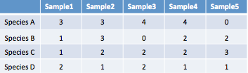
A typical pipeline of metagenome diversity analysis
Sample1
Reads
Assembly
Contigs
Sequencing
1000+ bp
100-150 bp
Abundance
Species
Binning
3x
1x
1x
2x
Species A
Species B
Mapping
Species C
Species D
Samples by species table
Challenges:
Assembly? - difficult (eg. Only small portions of reads can be assembled)
Binning? – difficult (eg. may need reference genomes, computationally expensive)
Mapping? – difficult (eg. accuracy, computationally expensive)
4 petabase pairs of DNA in a gram of soil(Jack A. Gilbert,2013)
Notes:
So the wuqesiton is can we find a shortcut, to do diversity anslyiss, alike get the clustering, without ….
We have been looking for such shortcut for a long time. The first try looks straightforward. Coutning k-mers.

Slide 17
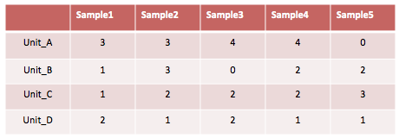
A typical pipeline of metagenome diversity analysis
Sample1
Reads
Assembly
Contigs
Sequencing
1000+ bp
100-150 bp
Abundance
Species
Binning
3x
1x
1x
2x
Species A
Species B
Mapping
Species C
Species D
Species-by-sample table
Notes:
Actually we did find such unit finally.
The first thing we think of is kmers,

Slide 18
Reads -> k-mers
>24288227
TTTGCCTGTTGAAAACCTGTAAACGGGATGTTTCCGGGGTTTTCCGCCCCGGTAGGGTTGAGACGTGCCCCGCGGTCGCGAACAGCTCGCCGCTTACCGGCGTAAGAGCGATCCGCAACACACCCCGGAGCCTCTACCCCCCCCTCACGC
TTTGCCTGTT
TTGCCTGTTG
TTTCCGGGGT
TTCCGGGGTT
TTCCGGGGTT
ATCCGCGGTT
TTCCGGGGTT
TTCCGGGGTT
TTCCGGCCGTT
GGTTTTTCCG
K-mer : DNA segment with length of k.
Notes:
So k-mer is the dna segment with length of k.
it’s like We slide the winodw with length of k from the beginning of read to the end and get the k-mers.
It represent the basic unit of information of a reads dataste.

Slide 19
Counting (unique) k-mers to evaluate diversity
Reads – sample A
K-mers – sample A
Reads – sample B
K-mers – sample B
Notes:
So we can chop the reads into numerous k-mers for each samples.
The hypothesis is that we can measure the diversity of samples, by counting the k-mers,.
For example the number of unqiue k-mers should be related to the richness of sample, more unique k-mers means there are more species.
We can also count the number of k-mers shared by two samples to measure the similarity.
The more number of unique k-mers shared by the sampels, the more similar they are.

Slide 20
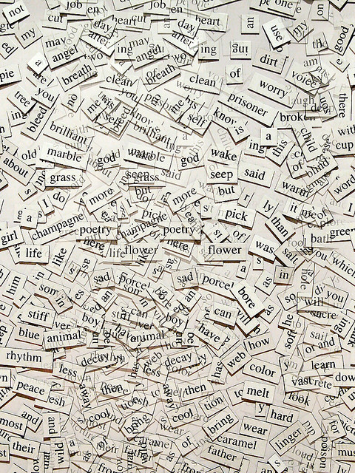

Counting (unique) words to evaluate diversity
Reads – sample A
K-mers – sample A
Reads – sample B
K-mers – sample B
Notes:
If we still use the book diversity as an analog. Its’like we try to count words to measure the number of titles of books in a library. And count the shared words we find to compare the collections of libraries.

Slide 21
Challenges in counting k-mers
handle large number of k-mers. (simple hash table will not work)
retrieve count of k-mer randomly (in-memory).
To check the occurrence of a k-mer in multiple samples to find shared k-mers
Soil metagenome sample | Number of reads | Number of k-mers k=29 | Number of unique k-mers
IOHH.2301.7.1859 | 273,021,397 | 32,762,567,744 | 22,333,571,795
Notes:
Counting, k-mers, it is easy to think of hash tables. But it is not efficient to handle the huge number of k-mers in metagenome data sets.
Also we need to retrieve counto f….
Becaseu fo . Means we need to have the count of all the k-mers in
At that time, we couldn’t find a k-mer counting tools that can do these efficiently. So we decided to make our own k-mer counting tool.

Slide 22
Outline
Background and motivation
An efficient k-mer counting approach
Novel method to investigate microbial diversity
Concept of IGS (informative genomic segment)
Testing IGS method on simulated data sets
Testing IGS method on real metagenome data
Summary
An efficient k-mer counting approach

Slide 23
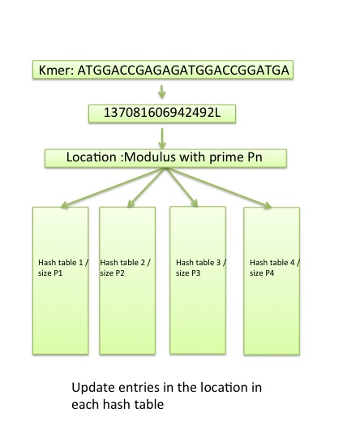
Khmer - An efficient k-mer counting approach
The Count-min Sketch consists of one or more hash tables of different size
Each entry in the hash tables is a counter representing the number of k-mers that hash to that location
To retrieve the count for a given k-mer we select the minimum count across all of the hash entries.
Highly scalable: Constant memory consuming, independent of k and dataset size
Probabilistic properties well suited to next generation sequencing datasets
Memory usage is fixed and low, with certain counting false positive rate as tradeoff because of collision
The one-sided counting error is low and predictable.
Notes:
To enable scalable k-mer counting and in memroy counting and count retrieval, we use the count-min sketch. Count-min sketch is lie a bloom filter with the ability to store abundance. Like a bloomf ilter, the count consits of …
Each entry in the …
To retireve the , minimum count, this is why it is called count and min.
This approach is higly. With constant memroy consuming. It will neven break a predefined memory usage threshold.
The probablistic proer, suites, there wil be one sided error.
Accury counting sis not required.

Slide 24
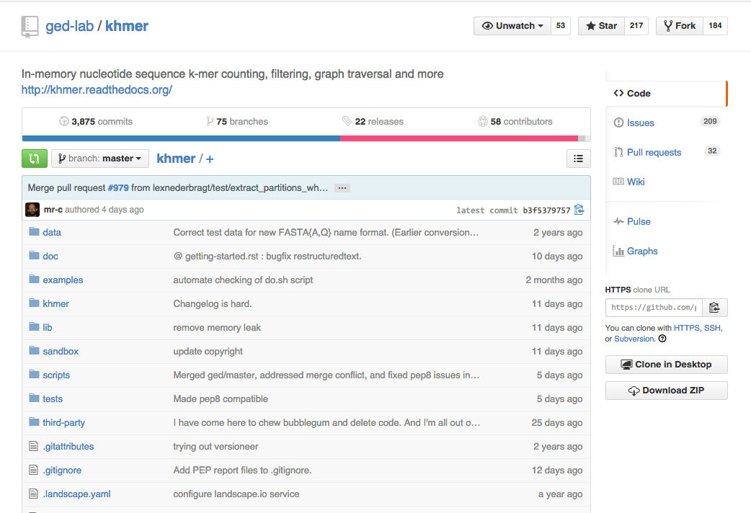
An efficient k-mer counting approach
My contributions:
algorithm design/analysis, exploring the mathematics behind, the choice of optimal parameters
contributing codes, including unique k-mers counting, overlap k-mer counting, optimal parameter choice, others related to my specific research project.
benchmarking, testing
exploration of applications like error trimming, filter low abundance reads, digital normalization, etc. suggestion on features
work on the khmer manuscript
Notes:
Other applications.
Open sources github, 50 contributors,
My contribution
Khmer is open sourced, hosted on github. Although the initial notivation of khmer is to count k-mer for diversity measurement., it has been widely used for other purposes, like assembly error analysis. It is a team effort. Now there are almost 60 contribors working locally or remotely.
My contributions include algorithm design and analyiss, contributing codes, benchmarking and work about manuscript.
I just want to say To be a developer and a user at the same time is a good experience.

Slide 25
Sequencing errors cause serious problem
>24288227
TTTGCCTGTTGAAAACCTGAAAACGGGATGTTTCCGGGGTTTTCCGCCCCGGTAGGGTTGAGACGTGCCCCGCGGTCGCGAACAGCTCGCCGCTTACCGGCGTAAGAGCGATCCGCAACACACCCCGGAGCCTCTACCCCCCCCTCACGC
c
In high coverage reads data set, most of the unique k-mers are erroneous caused by sequencing errors.
GAAAACCTGA
AAAACCTGAA
Counting k-mer to measure diversity directly?
AAACCTGAAA
Notes:
So now we have the efficient k-mer countign tool,
Can we count k-mer to measure diversity?
Unfortunalty, the sequencing er. Cause serious problems.
One error will generate up to k k-mers.
In high …
It is just too difficult to perform any analysis with so many erroneous k-mers to count.

Slide 26

Sequencing errors cause serious problem
>24288227
TTTGCCTGTTGAAAACCTGAAAACGGGATGTTTCCGGGGTTTTCCGCCCCGGTAGGGTTGAGACGTGCCCCGCGGTCGCGAACAGCTCGCCGCTTACCGGCGTAAGAGCGATCCGCAACACACCCCGGAGCCTCTACCCCCCCCTCACGC
c
In high coverage reads data set, most of the unique k-mers are erroneous caused by sequencing errors.
GAAAACCTGA
AAAACCTGAA
Counting k-mer to measure diversity directly?
AAACCTGAAA
Notes:
So we look for alternate approach, which turned out to be the igs based method.

Slide 27
Outline
Background and motivation
An efficient k-mer counting approach
Novel method to investigate microbial diversity
Concept of IGS (informative
Testing IGS method on simulated data sets
Testing IGS method on real metagenome data
Summary
Concept of IGS (informative genomic segment)

Slide 28
A typical pipeline of metagenome diversity analysis
Sample1
Reads
Assembly
Contigs
Sequencing
1000+ bp
100-150 bp
Abundance
Species
Binning
3x
1x
1x
2x
Species A
Species B
Mapping
Species C
Species D
Species-by-sample table
Notes:
Actually we did find such unit finally.
Kmers does not work.
What about reads. Upper level. Less prone to errors.
Something similar to reads.
Better than reads.

Slide 29
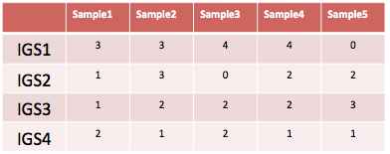
Replace samples-by-species table with samples-by-IGSs table
IGS (informative genomic segment)
can represent the novel information of a genome
can be used as a new unit to do diversity analysis to replace species
Assembly-free
Reference-free
Efficient and scalable
Notes:
Which is just the igs.3 25 min
It is called inof.. Because it can represent the novel
We can use igs as the replacement of speces and out.
It is the shortcut, so it is free, r free,efficient and sacable
We can get the count of igs across samples from raw reads.
.
Next I will itnroduce how to get the samples by igss table if we only have the sequencing reads in diff samples.

Slide 30
From reads to IGSs
We can use median k-mer abundance to estimate the sequencing coverage of a read without a reference assembly.
We can retrieve the coverage of a read across different samples.
If a read has a coverage as C, there will be approximately other C-1 reads with the same coverage covering the same DNA region.
We can estimate the size of covered genomic region by the number of reads and the corresponding coverage.
Four tricks!
Notes:
The whole procedure is kind of tricky. And it is a long way here If I look back.
And there are 3 clever tricks in the procuedure to enable the igs.
Firstly, ..
The second t
The thirs.
Now you must be lost and have no idea what they mean don’t worry
I will discuss more when we come acrossl the trikcs enxt.

Slide 31
Reads – sample A
K-mers – sample A
Coverage of read: the sequencing depth of the DNA region that read originates from
Coverage of a read and how to get it without a reference assembly
The abundance of the k-mers in a read tends to be similar, which is close to the coverage of the read.
Notes:
Covearge definiton, sequencing depth—
Lets’ see the reads in a sample. some reads have higher coverage and some reads have lower coverage. Here covera means the sequencing depth of the dna …
Coverage of a read is the sequencing depth of the genomic segment this read covers. , how many reads cover this region.
Because the reads are scattered across the genome randomly. Here we are talking about average. And only works for large number of reads.
The abundance of the k-mers in a read tends to be similar, which is close to the sequencing depth of the DNA region that read originates from.
The more times a region is sequenced, the higher the abundance of k-mers from that region would be.

Slide 32
Reads – sample A
K-mers – sample A
>24288227
TTTGCCTGTTGAAAACCTGTAAACGGGATGTTTCCGGGGTTTTCCGCCCCGGTAGGGTTGAGACGTGCCCCGCGGTCGCGAACAGCTCGCCGCTTACCGGCGTAAGAGCGATCCGCAACACACCCCGGAGCCTCTACCCCCCCCTCACGC
TTTGCCTGTT
4
4
5
TTTCCGGGGT
5
K-mer abundance
TTGCCTGTTG
4
TTCCGGGGTT
5
4
TTCCGGGGTT
4
GAAAACCTGT
ATCCGCGGTT
4
5
TTCCGGGGTT
3
AAAACCTGTA
TTCCGGGGTT
4
TTCCGGCCGTT
5
AAACCTGTAA
4
GGTTTTTCCG
Notes:
For this read, the frequcne, will be similar around 4 , may say the coveage is 4.

Slide 33
Reads – sample A
K-mers – sample A
x
x
>24288227
TTTGCCTGTTGAAAACCTGAAAACGGGATGTTTCCGGGGTTTTCCGCCCCGGTAGGGTTGAGACGTGCCCCGCGGTCGCGAACAGCTCGCCGCTTACCGGCGTAAGAGCGATCCGCAACACACCCCGGAGCCTCTACCCCCCCCTCACGC
TTTGCCTGTT
4
4
5
TTTCCGGGGT
5
K-mer abundance
TTGCCTGTTG
4
TTCCGGGGTT
5
1
TTCCGGGGTT
4
GAAAACCTGA
ATCCGCGGTT
4
1
TTCCGGGGTT
3
AAAACCTGAA
TTCCGGGGTT
4
TTCCGGCCGTT
5
AAACCTGAAA
1
GGTTTTTCCG
Notes:
However like the sequencing error cause serious problms when tried to use kmer counting to measure .. Directly.
The sequencing error stilll is a problem. It will drop the abundance of up to k kmers to 1.

Slide 34
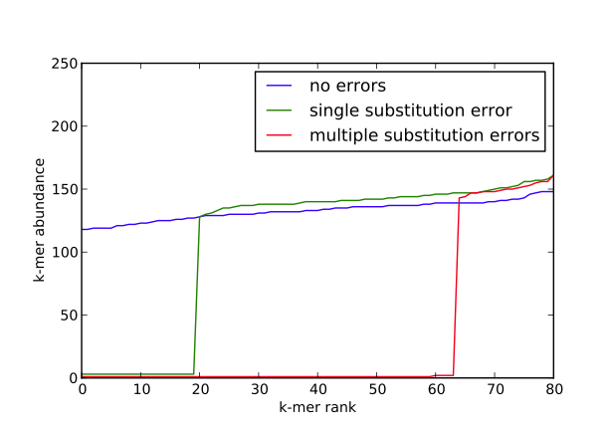
median k-mer abundance to represent the sequencing coverage of the read
>24288227
TTTGCCTGTTGAAAACCTGAAAACGGGATGTTTCCGGGGTTTTCCGCCCCGGTAGGGTTGAGACGTGCCCCGCGGTCGCGAACAGCTCGCCGCTTACCGGCGTAAGAGCGATCCGCAACACACCCCGGAGCCTCTACCCCCCCCTCACGC
TTTGCCTGTT
4
4
5
TTTCCGGGGT
5
TTGCCTGTTG
4
TTCCGGGGTT
5
1
TTCCGGGGTT
4
GAAAACCTGA
ATCCGCGGTT
4
1
TTCCGGGGTT
3
AAAACCTGAA
TTCCGGGGTT
4
TTCCGGCCGTT
5
AAACCTGAAA
1
GGTTTTTCCG
Notes:
If we rankthe abundanc of the kmer in a read , we can see the green curve in this figure,
If there is on esubstituion error, so many will be 1.
But it will not affect the median kmers

Slide 35
median k-mer abundance to represent the sequencing coverage of the read
Trick 1: We can use median k-mer abundance to estimate the sequencing coverage of a read without a reference assembly.
Notes:
Using median k-mer abundance to .. Less prone to sequencing erros.
Using simulated data and real data ,we can see the linear corealation between .. And …

Slide 36
Reads – sample A
K-mers – sample B
Trick 1: We can use median k-mer abundance to estimate the sequencing coverage of a read without a reference assembly.
Trick 2: We can estimate the sequencing coverage of a read across different samples
Notes:
Based on trik 1, we can geth coverage of raed in the sample, wehre
We can also estimate across. Still check the k-mer abundance of a read in another sample.

Slide 37
Sample A
Coverage = 4
Read Coverage Profile:
Sample B
A:B:C
4:6:2
Coverage = 6
Sample C
Coverage = 2
Notes:
So for mutilple samples, for each read we can get the covearge acros sam
Finally we get a profile alike his.

Slide 38
3:2:2
2:4:3
2:0:3
Sample A
3:2:2
3:2:2
2:0:3
2:0:3
3:2:2
3:2:2
3:2:2
2:4:3
2:0:3
Sample B
3:2:2
2:4:3
2:4:3
3:2:2
2:4:3
3:2:2
2:4:3
3:2:2
3:2:2
Sample C
2:0:3
2:4:3
2:4:3
2:0:3
2:0:3
3:2:2
3:2:2
2:0:3
2:0:3
2:4:3
2:0:3
3:2:2
Notes:
So we can get all the coverage profiles of all the reads in sample.s
I
----- Meeting Notes (4/29/15 03:24) -----

Slide 39
3:2:2
2:4:3
2:0:3
Sample A
3:2:2
3:2:2
2:0:3
2:0:3
3:2:2
3:2:2
3:2:2
2:4:3
2:0:3
“Contigs with similar coverage profiles are likely to have originated from the same microbial population” (Imelfort et al. 2014)
Reads with similar coverage profiles are likely to have originated from the same species.
Sample B
3:2:2
2:4:3
2:4:3
3:2:2
2:4:3
3:2:2
2:4:3
3:2:2
3:2:2
Sample C
2:0:3
2:4:3
2:4:3
2:0:3
2:0:3
3:2:2
3:2:2
2:0:3
2:0:3
2:4:3
2:0:3
3:2:2
Notes:
We have known that …
It is a new appraoch contigs actually.
It is the same for reads.
We propose that they are likely be the observations of the same genomic regions.

Slide 40
3:2:2
2:4:3
2:0:3
3:2:2
3:2:2
2:0:3
2:0:3
3:2:2
3:2:2
3:2:2
2:4:3
2:0:3
Genomic Content Sample A
3:2:2
2:4:3
2:4:3
3:2:2
2:4:3
3:2:2
2:4:3
3:2:2
Do the reads in each bin cover the same size of genomic region?
6 reads with coverage of 3 in the sample where they are from
Genomic Content Sample B
3:2:2
VS
2:0:3
2:4:3
2:4:3
2:0:3
2:0:3
2 reads with coverage of 2 in the sample where they are from
3:2:2
3:2:2
2:0:3
2:4:3
bin 1
bin 2
2:0:3
bin 3
2:0:3
3:2:2
Genomic Content Sample C
Notes:
We can group the reads with the same covera profile into different bins. Since they are morelikely to belong to the same species.
The reads in each bin should cover a specific size of genomic region.
What is the size of the region? Do the …?
Like 6 reads with …
2 …
??
Let ‘s take a cloer look to the reads from sample A

Slide 41
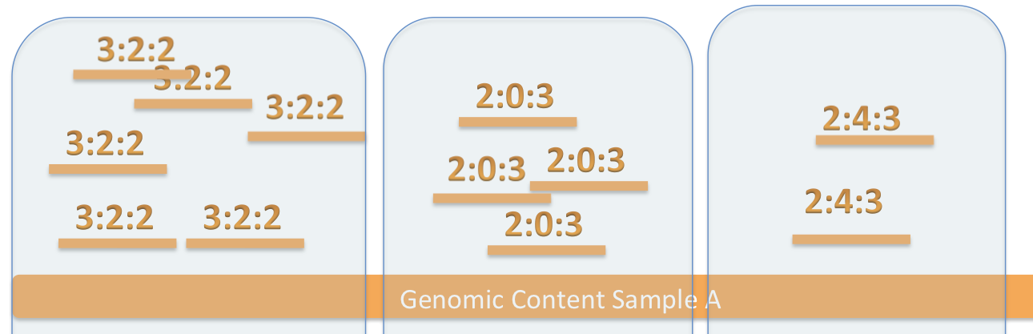
What is the size of genomic region covered by the reads in each bin?
What we know:
C: coverage of the read in the sample in the bin
N: number of reads in the bin
Notes:
Here we want to know the size of genomic region the reads in each bin cover…
What we know now is the ,.. C
And .. N

Slide 42
Reads – sample A
K-mers – sample A
Trick 3: If a read has a coverage as C, there will be approximately other C-1 reads with the same coverage covering the same DNA region.
Notes:
Now we introduce the 3rd trick.
If ther eis one read with blue color has a coverage like 6 covering this region
There must be other 5. the same.
The same for the yellow.

Slide 43
Reads – sample A
Trick 4: We can estimate the size of covered genomic region by the number of reads(N) and the corresponding coverage(C).

Slide 44
Reads – sample A
N ~= 30, C ~= 10
N ~= 7, C ~= 7
Trick 4: We can estimate the size of covered genomic region by the number of reads(N) and the corresponding coverage(C).
Notes:
C= 10, there 10 reads cover the same region.
30 reads , size of the region,

Slide 45
Reads – sample A
N ~= 30, C ~= 10
N ~= 7, C ~= 7
Size of covered DNA region
N/C = 30/10 = 3
N/C = 7/7= 1
Trick 4: We can estimate the size of covered genomic region by the number of reads(N) and the corresponding coverage(C).

Slide 46
Reads – sample A
N ~= 30, C ~= 10
N ~= 7, C ~= 7
Size of covered DNA region
N/C = 30/10 = 3
N/C = 7/7= 1
Unit of size of covered DNA region: IGS - IGS(informative genomic segment)
Trick 4: We can estimate the size of covered genomic region by the number of reads(N) and the corresponding coverage(C).
Notes:
What is the 3 actually? 3 what?
Here we define such unit as igs.
Ther e3 igs covered by 30 with coverage as 10 .. The sme

Slide 47
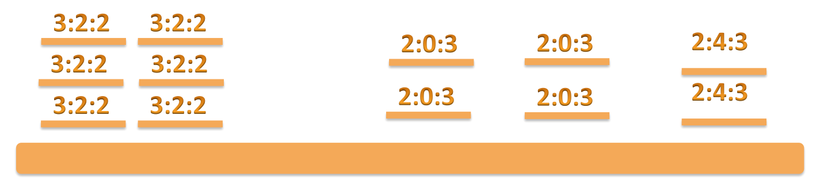
Do the reads in each bin cover the same size of genomic region?
6 reads with coverage of 3 in the sample where they are from
VS
2 reads with coverage of 2 in the sample where they are from
6/3 = 2
4/2 = 2
2/2 = 1
Notes:
Lets go back to he questions.
With trick 4. we can say 2 igs coveraeg ,2 . 1 by

Slide 48
3:2:2
3:2:2
2:0:3
2:0:3
2:4:3
3:2:2
3:2:2
2:0:3
2:0:3
2:4:3
3:2:2
3:2:2
 | SampleA | SampleB | SampleC
IGS1 | 3 | 2 | 2
IGS2 | 3 | 2 | 2
IGS3 | 2 | 0 | 3
IGS4 | 2 | 0 | 3
IGS5 | 2 | 4 | 3
2:4:3
3:2:2
3:2:2
2:4:3
3:2:2
3:2:2
2:4:3
2:4:3
3:2:2
3:2:2
2:4:3
2:0:3
2:0:3
3:2:2
3:2:2
2:0:3
2:0:3
2:4:3
2:0:3
2:0:3
2:4:3
Notes:
The same for other samples. The reads in each bin was same coveage profile, they should covera the same genomic region. The same igss.
So thes igs are shared by the samples.
And we can get the abundance of these igss.
So now we have the .. By table.
With this table

Slide 49
A typical pipeline of metagenome diversity analysis
Sample1
Reads
Assembly
Contigs
Sequencing
1000+ bp
100-150 bp
Abundance
Species
Binning
3x
1x
1x
2x
Species A
Species B
Mapping
Species C
Species D
Species-by-sample table
Challenges:
Assembly? - difficult (eg. Only small portions of reads can be assembled)
Binning? – difficult (eg. may need reference genomes, computationally expensive)
Mapping? – difficult (eg. accuracy, computationally expensive)
4 petabase pairs of DNA in a gram of soil(Jack A. Gilbert,2013)
Notes:
Now we have igs and we find the short cut, and do diversity anslsyis.
We can measure diversity basedon the by tables. Finally.

Slide 50
IGS(informative genomic segment) can represent the novel information of a genome
IGS (informative genomic segment): genomic segments that do not share genomic content with the same length of read
The more IGSs there are in a sample, the higher diversity , higher richness the sample has.
The more IGSs two samples share, the more similar the two samples are.
(meta)Genome size = number of IGSs x IGS length (read length)
Notes:
So what is igs actually then?
Actually they are the ….
Then rpresented , the more .. The more..
Also if we can estimate the number of igs we can also estimate the .. Genome.

Slide 51
Outline
Background and motivation
An efficient k-mer counting approach
Novel method to investigate microbial diversity
Concept of IGS (informative genomic segment)
Testing IGS method on simulated data sets
Testing IGS method on real metagenome data
Summary
Testing IGS method on simulated data sets
Notes:
Next we test the igs me…
On to see how .

Slide 52
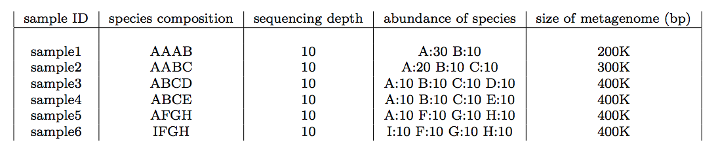
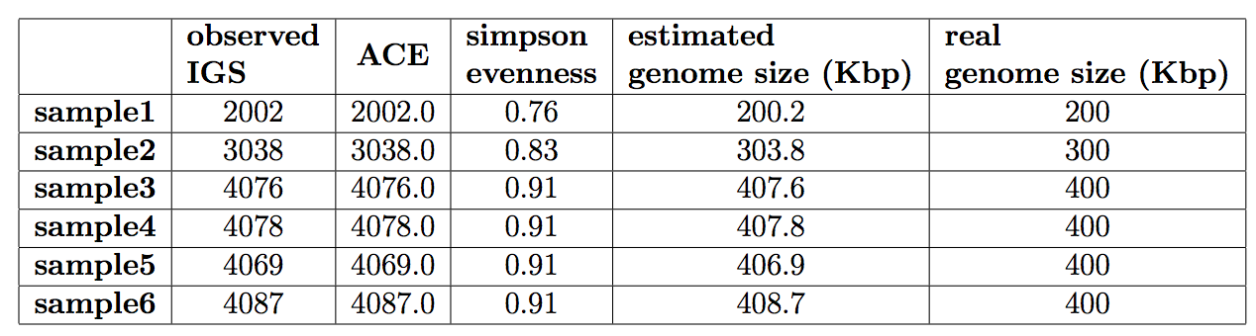
Simulated data sets with different species composition
No sequencing error is introduced in this simulated data
Estimated (meta)genome size matches real size perfectly.
Evenness metric can represent species distribution correctly
Notes:
First we simulate the 6samples with difeent specis compositoin . We simulated reads with same sequencing depth, and no errors.
Using igs method, we can estimate the metagenome size
6
Got igs and

Slide 53
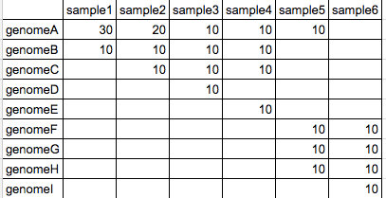
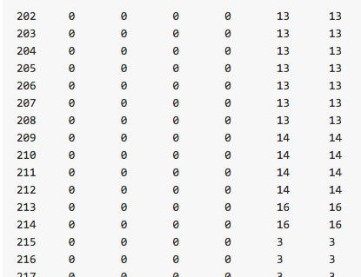
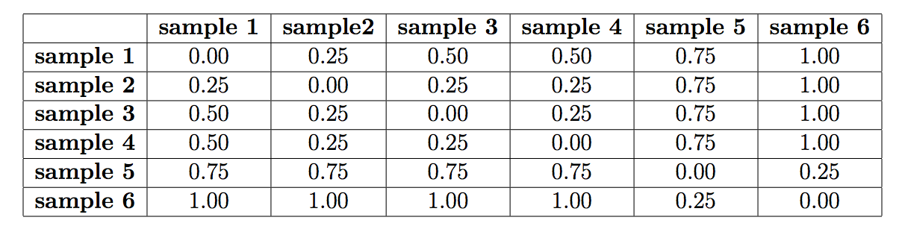
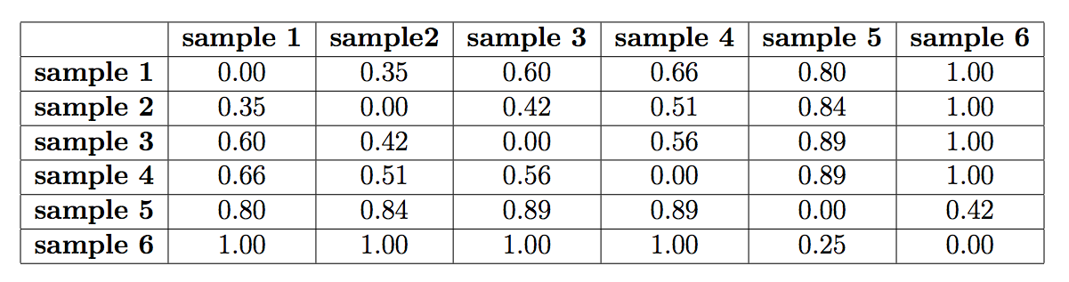
Samples-by-species table
Samples-by-IGSs table
Ground truth
^{Mantel Correlation:}
^{0.9714}
Using IGS method
Calculated dissimilarity matrix matches the matrix calculated from species composition.
Notes:
To evaluate the accuracy of beta diversity analysis.firstly we calcuate the dissimialrt matrix from the known species compositon, since we know the truth.
Braycurtis metric, share 50 % of the contents.
We also use the igs method ot clcuate tmatrix, from igs by table.s
Now we have two matrix. We can us mantel to test how similar they are . Closer to 1 means they reflect the same relationship between .
So igs method ccna give matrix that reflect the tru ..

Slide 54

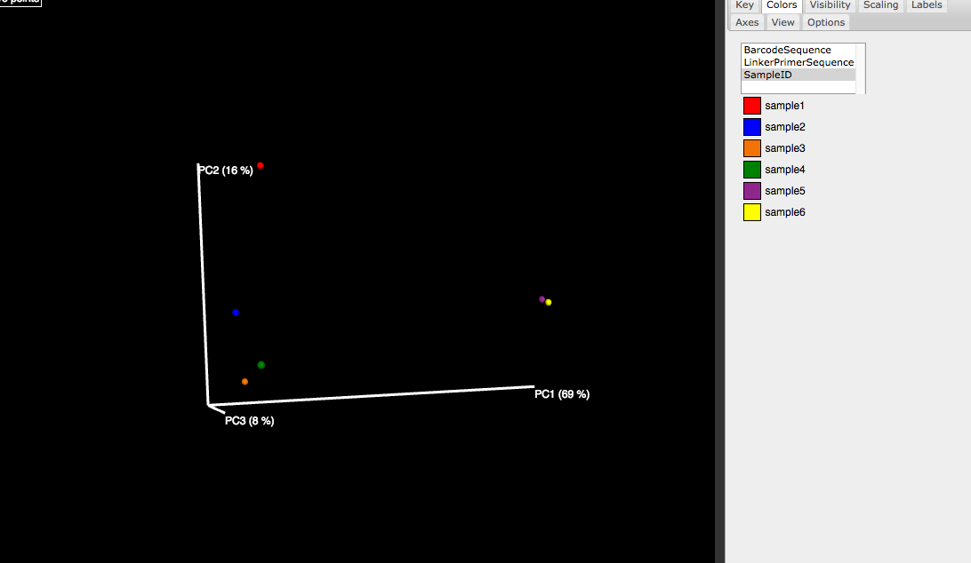
With an accurate dissimilarity matrix, it will be straightforward to perform PCoA or clustering analysis to demonstrate the relationship between samples.
Ordination (PCoA)
Clustering
AFGH
FGHI
ABCE
AABC
ABCD
AAAB
Notes:
From matrix , we do ordina see the elfelct the trure relaitonshp.

Slide 55
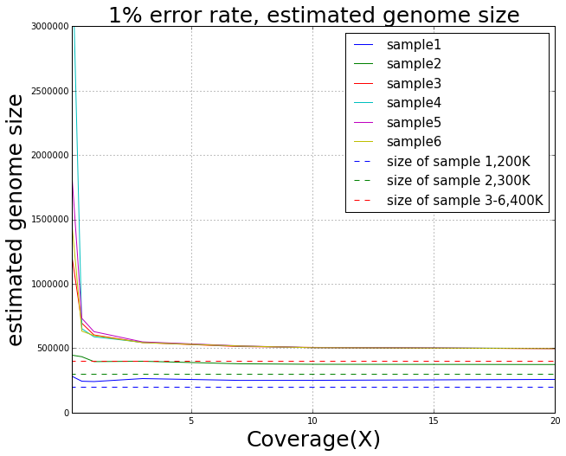
Influence of error rate and coverage to alpha diversity analysis
Metagenome size is more accurate with increasing coverage and lower error rate
Notes:
Next we check theinfluence of .
It is not surprising. With higher overage. , more accurate.
And with error, esitated is larger than real size. Proba due terrorous kmers.
But th relationship is corect enven thosu absolute not accurate.

Slide 56
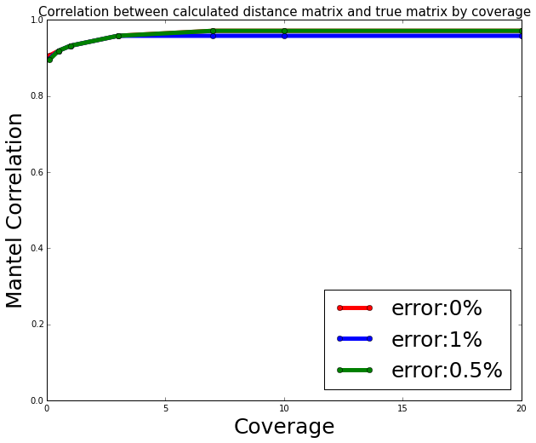
Influence of error rate and coverage to beta diversity analysis
Beta diversity is less prone to error rate and low coverage
Notes:
Beta, thisis nice, less prone. To
It is more dififcult to easita richness than comparison.
Like library fchinaese and msu library.
We don’t need to see many shrredde pages.
This is related to the simialrty bewte.
More simialr, need higher resolution, higher coverage. To see the trivial differnce.
If we can not see . We may need more data , more coverage.
But if we can see the difference. Should be reliable.

Slide 57
Outline
Background and motivation
An efficient k-mer counting approach
Novel method to investigate microbial diversity
Concept of IGS (informative genomic segment)
Testing IGS method on simulated data sets
Testing IGS method on real metagenome data
Summary
Testing IGS method on real metagenome data
Notes:
Next we test on two real metagenome dataset

Slide 58
Sorcerer II Global Ocean Sampling Expedition
It has been calculated that microbes in ocean account for about half of the biomass on Earth.
In a drop (one millilitre) of seawater, one can find 10 million viruses, one million bacteria
Notes:
Reasl data et, the sea water got sampled in diffenrelnt locations. Got sequenced. Got ther eaed with
Using igs methods.
Longer reads. older sequencing tech. 2007.
This is older, with longer reads, smaller datasets.

Slide 59


Samples can be separated by locations using IGS-based method – as good as the result in original research based on alignment-based method or better.
Tropical and Sargasso
Tropical - Galapogas
Tropical – Open Ocean
Sargasso
Temperate
Temperate - North
Temperate - South
Estuary
Notes:
Clustered by the locations. We can see the temprerate and tropocial are seperated succeffuly.
Actaul yif we check the cluster got by the authours,
One sample si clusteredinto wrong branch, but in our result, ti correct.
The location temperature, afect the compositon of microbial organisms.

Slide 60
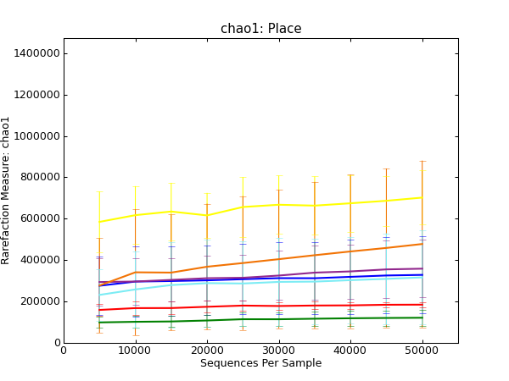
Alpha diversity analysis shows samples from tropical area have higher richness.
Sargasso
Tropical and Sargasso
Tropical - Open Ocean
Tropical - Galapogas
Temperate -South
Estuary
Temperate
Temperate - North
Notes:
Tropical has higher richness. Rlated to the nutrition.
This is not discussed explictly in the original paper. This makes sens.e

Slide 61
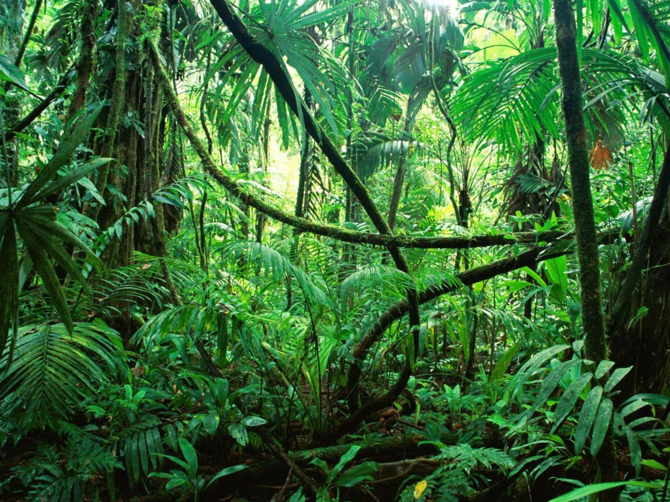
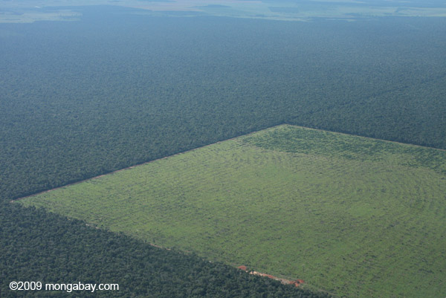
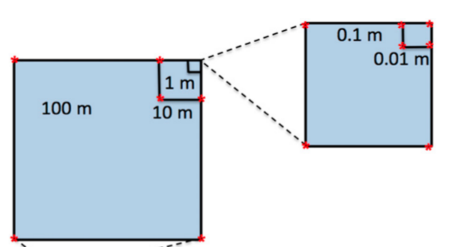
ARMO (Amazon Rain Forest Microbial Observatory) project
Soil metagenome sample | Number of reads | Number of k-mers k=29 | Number of unique k-mers
IOHH.2301.7.1859 | 273,021,397 | 32,762,567,744 | 22,333,571,795
21 samples, 1T size of data, 5 billion reads.
Notes:
The Amazon rainforest is the Earth’s largest reservoir of plant and animal diversity, and it has been subjected to especially high rates of land use change, primarily to cattle pasture.
The goal of this study is to understand the effect of agriculture practice (conversion of forest to pasture) on microbial community.

Slide 62
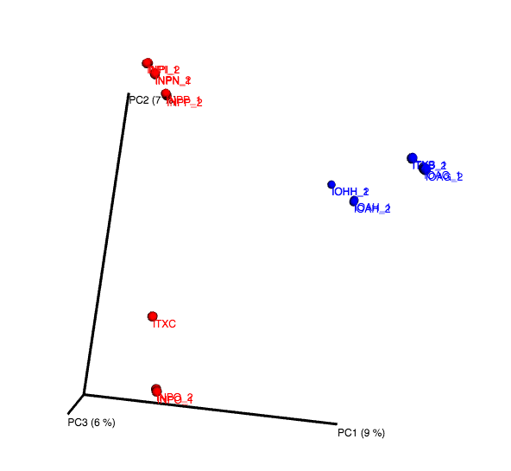
Blue: Prairie
Red: Forest
Conversion (forest -> pasture) affects composition
Prairie samples more similar in space
Subsamples with 8M reads are used.
Notes:
Can be seperated by treatment.
Our results show that bacterial community composition was significantly altered by the forest-to-pasture conversion.
Prairie smaller beta diversity than forest. Cultivation will influence the composition a lot.

Slide 63
Samples can be clustered by different treatments and distances using IGS method.
0.1m
0.01m
10m
100m
Blue: Prairie
Red: Forest
0.1m
0.01m
1m
10m
Notes:
Look at the clustering, distance got from the igs method correlates with the distance between sampling location pretty good.

Slide 64
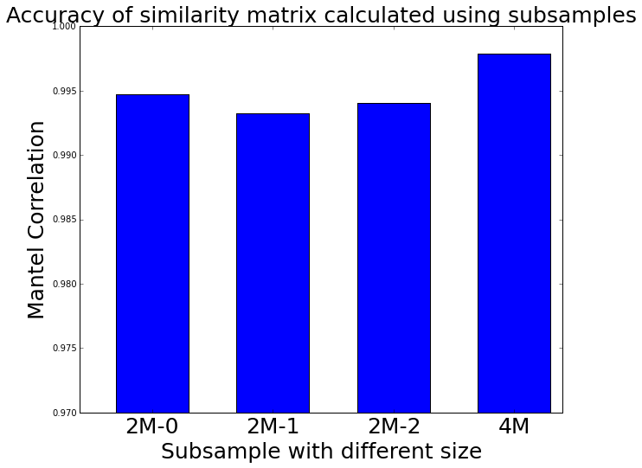
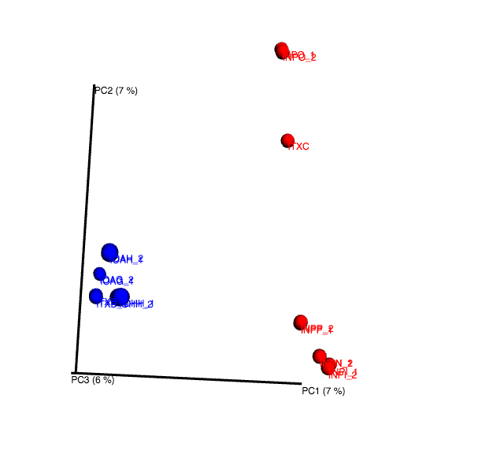
Blue: Prairie
Red: Forest
Mantel correlation to similarity matrix calculated from subsample with 8M reads
Using subsamples can get decent result of beta diversity.
Notes:
Previous analys are perfromed to sabsampels with 8m reads, a small proportion we can see the differene,
We have shown using simulated data, beta more reliable, less prone to ..
Now we use the real ata set to check again.
So we use threee diffeent subsampels with 2m reads, and 4milions
Calculate the

Slide 65
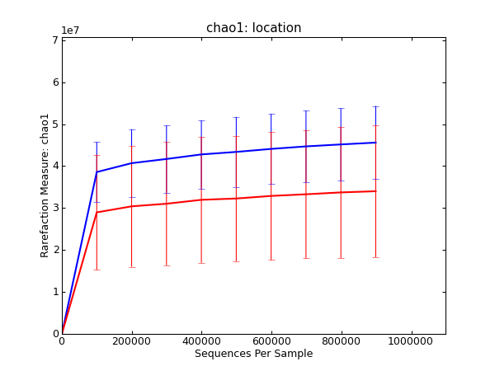
Blue: Prairie
Red: Forest
Alpha diversity analysis shows samples from prairie area have higher richness than forest area.
Notes:
Prairie have higher richness ,diversity ahn forest.
All these results are consistent to the result acquired by the auhoter of the project using traditional method, invlinvg assemlby, annotation.

Slide 66
Outline
Background and motivation
An efficient k-mer counting approach
Novel method to investigate microbial diversity
Concept of IGS (informative genomic segment)
Testing IGS method on simulated data sets
Testing IGS method on real metagenome data
Summary
Summary

Slide 67
Summary
A whole framework with potentials:
Take all information into account, rare species
Alpha diversity ( richness, evenness) (Chao1, ACE estimators, etc.)
Beta diversity ( abundance-based, incidence-based)
Integrate with existing packages (khmer, mothur, QIIME, scikit-bio,etc.)
Scalable, efficient:
Based on efficient k-mer counting
Using subsamples may be enough for specific task

Slide 68
What’s next
Extend applications beyond diversity analysis
Extracts interesting reads by coverage profile
Reads binning/classification based on reads coverage profile
Genome size estimation/sequencing effort evaluation
Refine pipeline, optimize performance
Adjust IGS resolution
Improve methods to handle large number of IGSs more efficiently
Iterative beta diversity analysis

Slide 69
Publications
IGS method
Using the concept of informative genomic segment to investigate microbial diversity of metagenomic sample (in preparation)
[stream Crossing the streams: a framework for streaming analysis of short DNA sequencing reads. Qingpeng Zhang, Sharon Awad, C. Titus Brown. (submitted) https://peerj.com/preprints/890/
[khmer] These are not the k-mers you are looking for: efficient online k-mer counting using a probabilistic data structure. Qingpeng Zhang, Jason Pell, Rosangela Canino-Koning, Adina Chuang Howe, C. Titus Brown. PLOS ONE, July 25, 2014, DOI: 10.1371/journal.pone.0101271 http://journals.plos.org/plosone/article?id=10.1371/journal.pone.0101271
[diginorm] A Reference-Free Algorithm for Computational Normalization of Shotgun Sequencing Data. C. Titus Brown, Adina Howe, Qingpeng Zhang, Alexis B. Pyrkosz, Timothy H. Brom. Submitted. http://arxiv.org/abs/1203.4802
[Osedax] Genomic versatility and functional variation between two dominant heterotrophic symbionts of deep-sea Osedax worms. Shana K Goffredi, Hana Yi, Qingpeng Zhang, Jane E Klann,Isabelle A Struve, Robert C Vrijenhoek and C Titus Brown. The ISME Journal doi:10.1038/ismej.2013.201
error analysis
khmer
digital normalization
seaworm symbiont
Notes:
Besides， kmer counting approache and Igs based diversity analysis approach, I have also worked some other projects, just don’t have time today for them. they are all related to diversity analysis in some way.

Slide 70
Acknowledgement
Committee members
Jaimes Cole
Richard Enbody
Yanni Sun
Eric Torng
Former members of GED
Dr. Adina Howe
Eric McDonald
Dr. Jason Pell
Dr. Likit Preeyanon
Dr. Elijah Lowe
khmer developers
Dr. Titus Brown
Lab members of GED
Dr. Sherine Awad
Michael Crusoe
Jiarong Guo
Luiz Irber
Camille Scott
Collaborators
Dr. James Tiedje
Dr. Joan Ross
Dr. Shana K Goffredi
Yiseul KIm

